Slide 1
Johnson’s algorithm for All-pairs shortest paths

Slide 2
Johnson's Algorithm uses both Dijkstra's Algorithm and Bellman-Ford Algorithm.
Johnson's Algorithm uses the technique of "reweighting."
If all edge weights w in a graph G = (V, E) are nonnegative, we can find the shortest paths between all pairs of vertices by running Dijkstra's Algorithm once from each vertex.
If G has negative - weight edges, we compute a new - set of non - negative edge weights that allows us to use the same method.

Slide 3
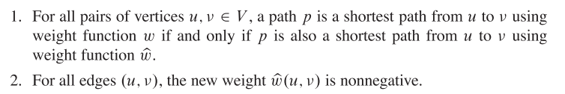

The new set of edges weight must satisfy two essential properties:
For each edge (u, v) ∈ E define
Where h (u) = label of u
h (v) = label of v

Slide 4
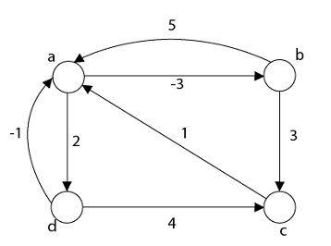
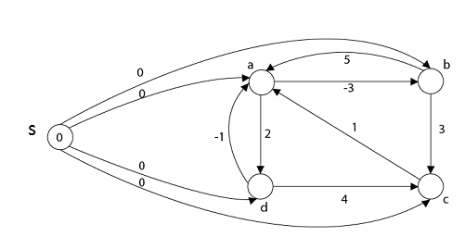
Step1: Take any source vertex's' outside the graph and make distance from 's' to every vertex '0'.

Slide 5


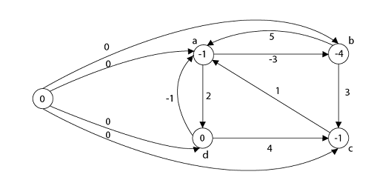
Step2: Apply Bellman-Ford Algorithm and calculate minimum weight on each vertex.
Dist | s | a | b | c | d
K=1 | 0 | 0 | 0 | 0 | 0
K=2 | 0 | -1 | -3 | 0 | 0
K=3 | 0 | -1 | -4 | 0 | 0
K=4 | 0 | -1 | -4 | -1 | 0
h(a)=-1
h(b)=-4
h(c)=-1
h(d)=0
s

Slide 6
Step3: w (a, b) = w (a, b) + h (a) - h (b)
= -3 + (-1) - (-4)
= 0
w (b, a) = w (b, a) + h (b) - h (a)
= 5 + (-4) - (-1)
= 2
w (b, c) = w (b, c) + h (b) - h (c)
w (b, c) = 3 + (-4) - (-1)
= 0
w (c, a) = w (c, a) + h (c) - h (a)
w (c, a) = 1 + (-1) - (-1)
= 1
w (d, c) = w (d, c) + h (d) - h (c)
w (d, c) = 4 + 0 - (-1)
= 5
w (d, a) = w (d, a) + h (d) - h (a)
w (d, a) = -1 + 0 - (-1)
= 0
w (a, d) = w (a, d) + h (a) - h (d)
w (a, d) = 2 + (-1) - 0 = 1

Slide 7
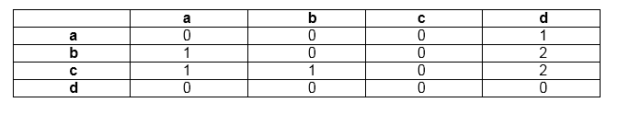
Step 4: Now all edge weights are positive and now we can apply Dijkstra's Algorithm on each vertex and make a matrix corresponds to each vertex in a graph

Slide 8
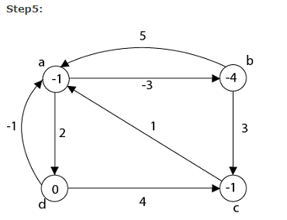
d_{uv} ← δ (u, v) + h (v) - h (u)
d (a, a) = 0 + (-1) - (-1) = 0
d (a, b) = 0 + (-4) - (-1) = -3
d (a, c) = 0 + (-1) - (-1) = 0
d (a, d) = 1 + (0) - (-1) = 2
d (b, a) = 1 + (-1) - (-4) = 4
d (b, b) = 0 + (-4) - (-4) = 0
d (c, a) = 1 + (-1) - (-1) = 1
d (c, b) = 1 + (-4) - (-1) = -2
d (c, c) = 0
d (c, d) = 2 + (0) - (-1) = 3
d (d, a) = 0 + (-1) - (0) = -1
d (d, b) = 0 + (-4) - (0) = -4
d (d, c) = 0 + (-1) - (0) = -1
d (d, d) = 0

Slide 9
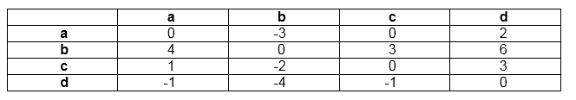
Final Result shortest distance from all vertices to each other

Slide 10
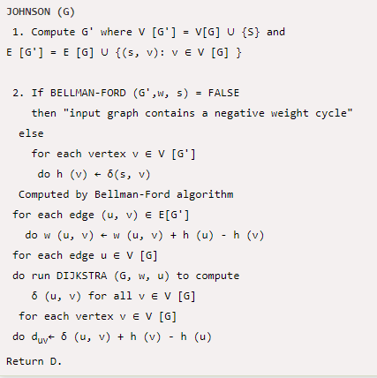
Algorithm

Slide 11
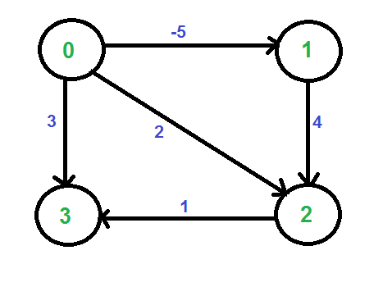
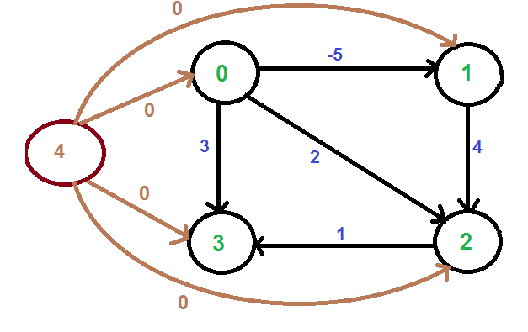

Slide 12
